Slide 1
Počítačová grafika III –
Všehochuť
Jaroslav Křivánek, MFF UK
Jaroslav.Krivanek@mff.cuni.cz

Slide 2
“Science, it works …
(bitches!)”
Quote from Richard Dawkins
http://www.youtube.com/watch?v=n6hxo1sC-dU

Slide 3

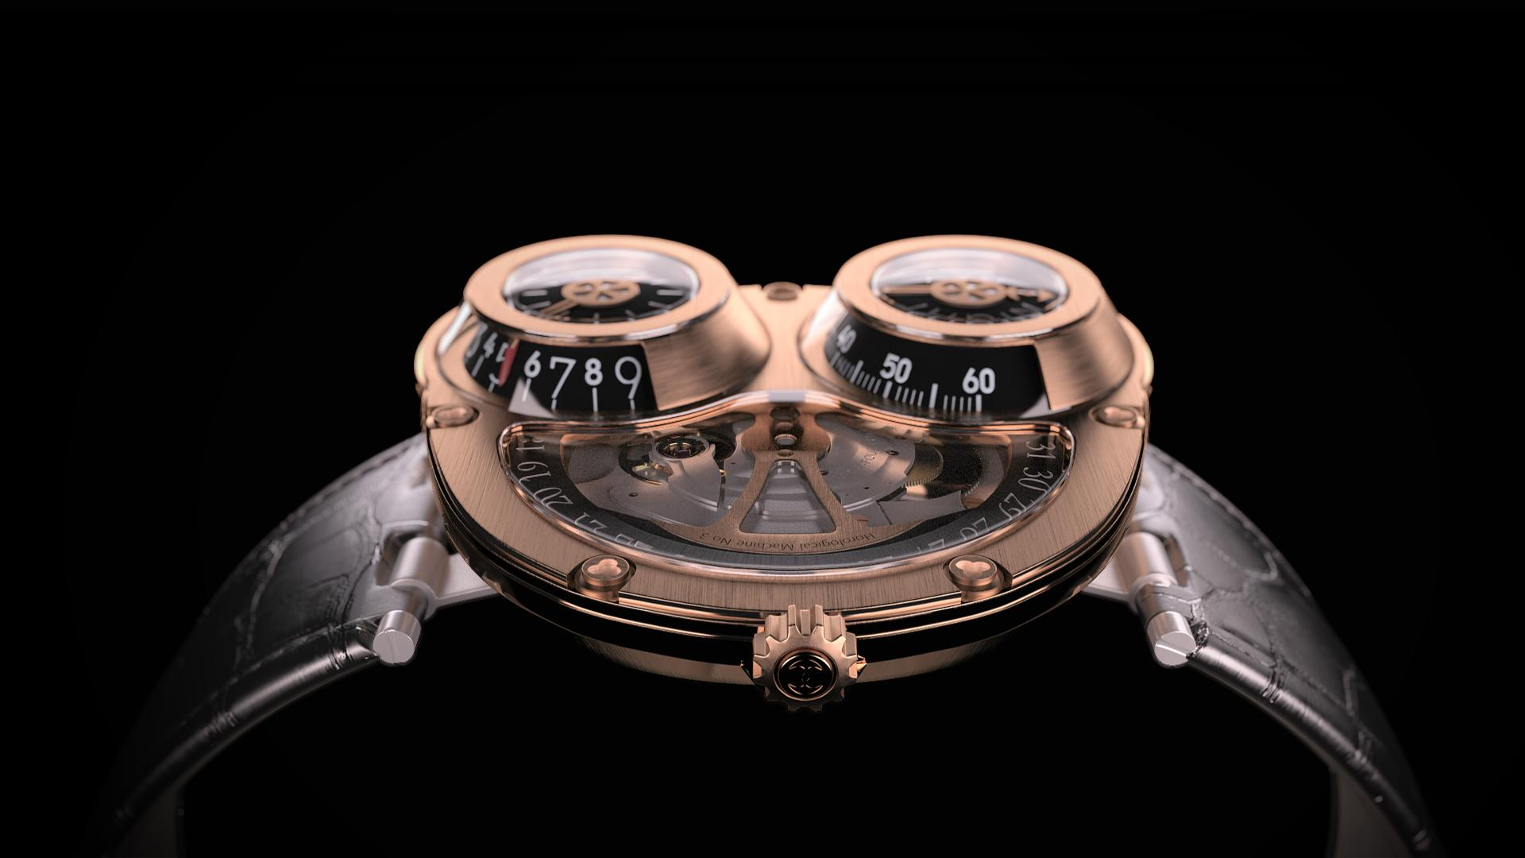
… and so does path tracing!
Jerome White

Slide 4

Path Tracing funguje!
Martin Geupel (DeadClown)

Slide 5
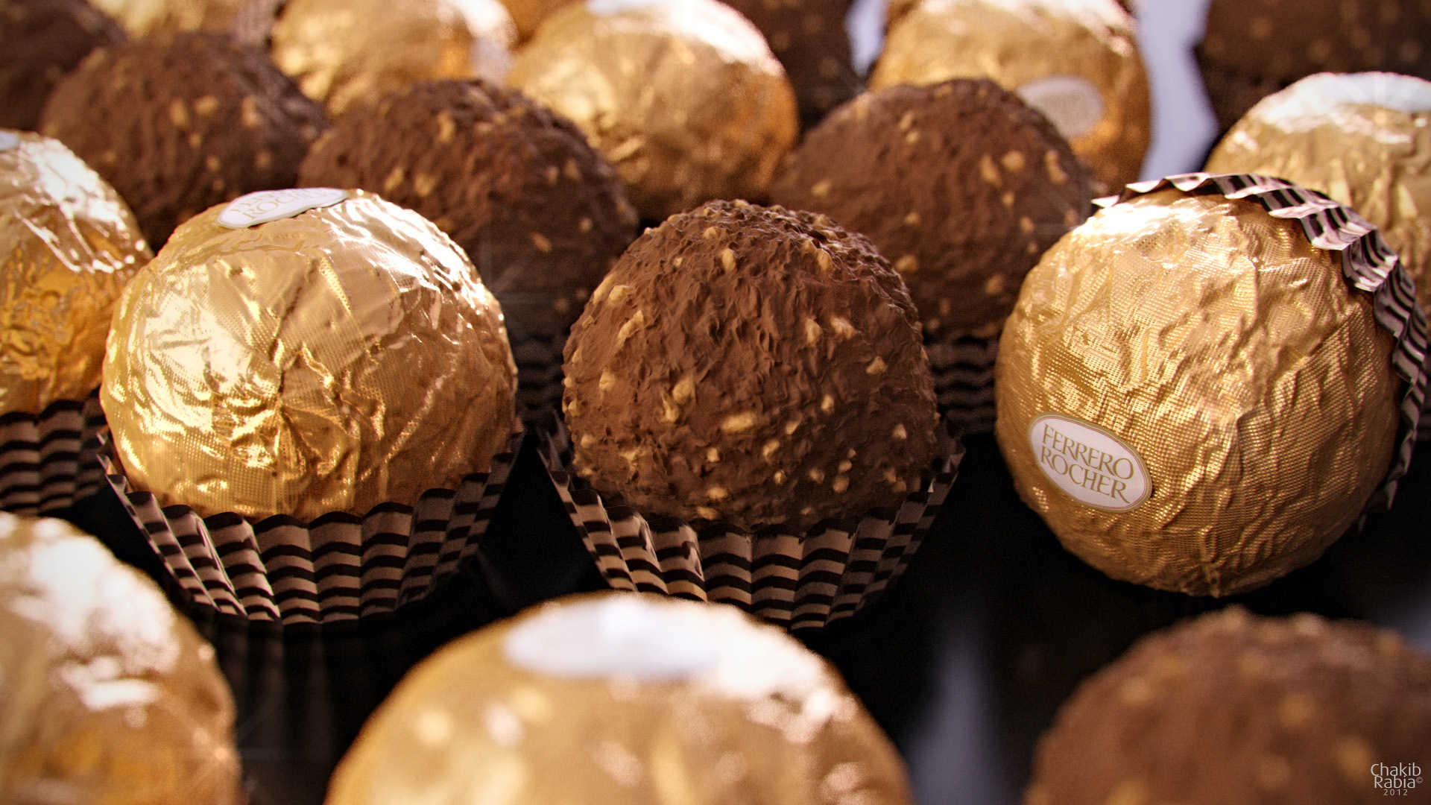
Path Tracing funguje!
Chakib Rabia

Slide 6
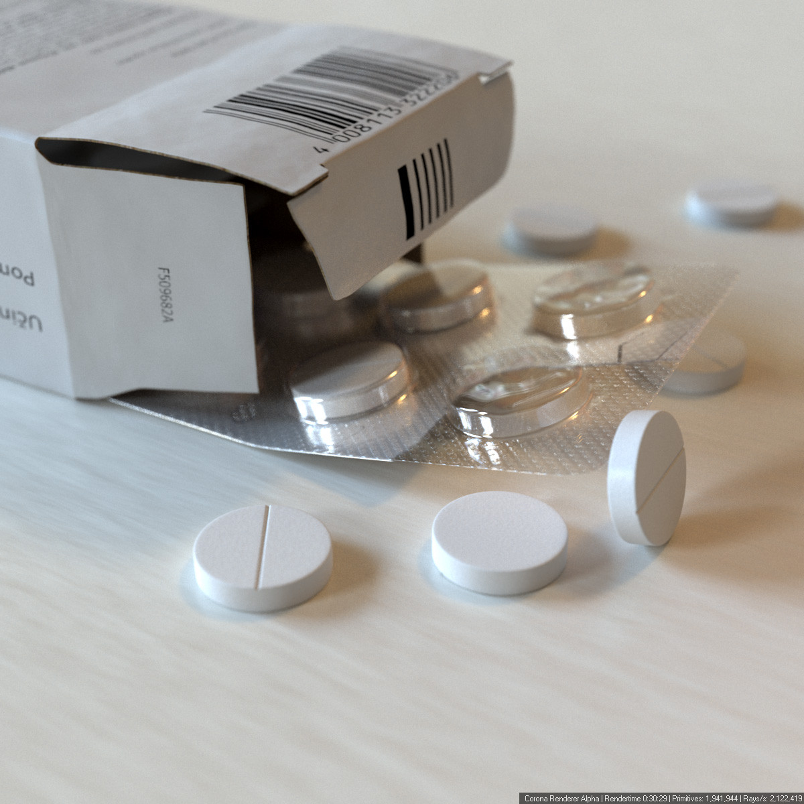
Ondra Karlík

Slide 7
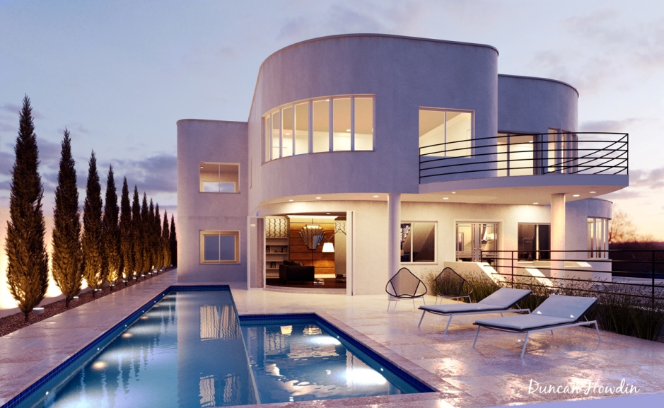
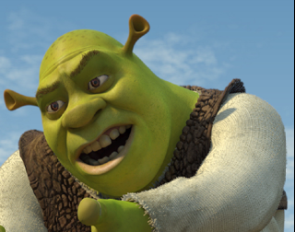
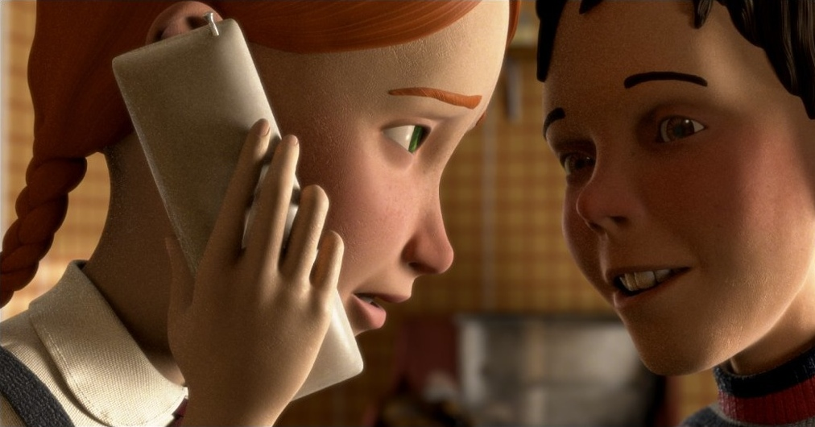
Light transport – Global illumination
Archviz
Movies
© Duncan Howdin
Image courtesy of Columbia Pictures.
© 2006 Columbia Pictures Industries, Inc.
Notes:
Light transport simulation is an essential component of rendering realistic images with global illumination.
It’s been a standard tool in architectural and product visualization for many years now, with maxwell renderer being one of the first commercially available solutions based on unbiased Monte Carlo simulation.
Its use in movies picked up later due to technical difficulties (large scenes, tighter rendering time budget).

Slide 8
Light transport – Global illumination
Movies
2002, Shrek 2
(PDI/Dreamworks)
  1 bounce indirect
2006, Monster House
(Sony Imageworks)
  Full light transport
  (path traced)
  Arnold renderer
Image courtesy of Columbia Pictures.
© 2006 Columbia Pictures Industries, Inc.
Notes:
The use of global illumination in feature film production started with PDI/Dreamwork’s Shrek 2. They used irradiance caching to compute a single bounce of diffuse indirect illumination – so not really the full light transport.
The Monster House in 2006 was probably the time that ray-based, accurate Monte Carlo light transport simulation was used in movie production.
It was rendered with the Arnold renderer – a brute force path tracer developed by Marcos Fajardo in collaboration with Sony Imageworks.

Slide 9
Light transport – Global illumination
Movies
2006, Monster House
(Sony Imageworks)
  Full light transport
  (path traced)
  Arnold renderer
Image courtesy of Columbia Pictures.
© 2006 Columbia Pictures Industries, Inc.
Full light transport simulation
  Accuracy
  Ease of use
  Visual consistency
Notes:
Arnold has in fact started a quiet revolution, where most VFX and animation studios are nowadays shifting toward rendering solutions based on physically plausible light transport simulation.
Advantages of this approach are indisputable
improved accuracy
easier rendering set up – no need for specialized solutions for different illumination effects
guaranteed visual consistency – the most important thing in movies!
The shift in movie production toward physically based light transport underlines the importance of research and development in this area. It is also one of the important motivations behind this course.

Slide 10

Light transport – Global illumination
More information
  “The State of Rendering”
Full light transport simulation
  Accuracy
  Ease of use
  Visual consistency
Notes:
A fairly detailed account on the state of rendering in the VFX community is given in a recent fxguide article “The State of Rendering”.
They also mention that the Vertex Connection and Merging algorithm will be used in PRMan 19 (http://cgg.mff.cuni.cz/~jaroslav/papers/2012-vcm/index.htm).

Slide 11
Quasi Monte Carlo Metody

Slide 12
Metody Quasi Monte Carlo (QMC)
Použití striktně deterministických sekvencí místo náhodných čísel
Vše funguje jako v MC, důkazy se ale nemohou opírat o teorii pravděpodobnosti (nic není náhodné)
Použité sekvence čísel s nízkou dikrepancí (low-discrepancy sequences)

Slide 13
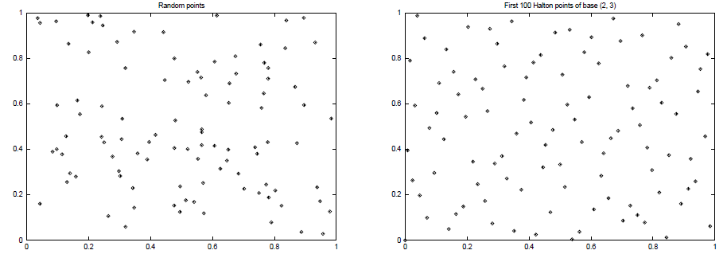
Diskrepance
High Discrepancy
(clusters of points)
Low Discrepancy
(more uniform)

Slide 14
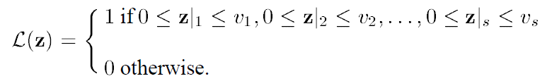

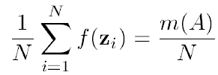
Defining discrepancy
s-dimensional “brick” function:
True volume of the “brick” function:
MC estimate of the volume of the “brick”:
number of sample points that
actually fell inside the “brick”
total number of sample points

Slide 15
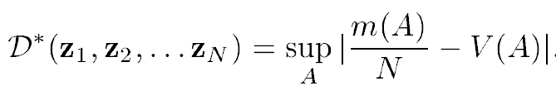
Discrepancy
Discrepancy (of a point sequence) is the maximum possible error of the MC quadrature of the “brick” function over all possible brick shapes:
  serves as a measure of the uniformity of a point set
  must converge to zero as N -> infty
  the lower the better (cf. Koksma-Hlawka Inequality)

Slide 16
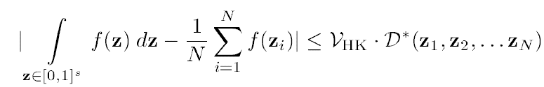
Koksma-Hlawka inequality
Koksma-Hlawka inequality
  the KH inequality only applies to f with finite variation
  QMC can still be applied even if the variation of f is infinite
„variation“ of f

Slide 17
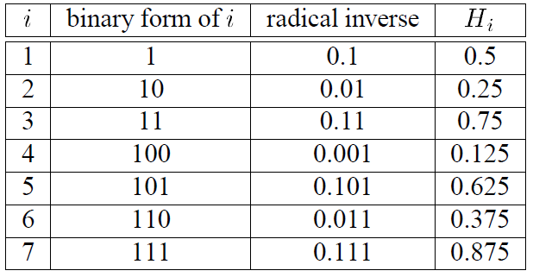
Van der Corput Sequence (base 2)
point placed in the middle of the interval
then the interval is divided in half
has low-discrepancy
Table credit: Laszlo Szirmay-Kalos

Slide 18
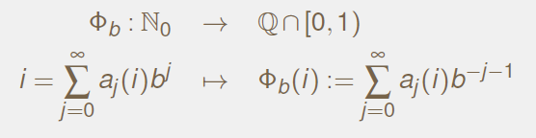
Van der Corput Sequence
b ... base, must be relative prime (2,3,5,7,....)
radical inverse

Slide 19
Van der Corput Sequence (base b)
double RadicalInverse(const int Base, int i)
{
double Digit, Radical, Inverse;
Digit = Radical = 1.0 / (double) Base;
Inverse = 0.0;
while(i)
{
Inverse += Digit * (double) (i % Base);
Digit *= Radical;
i /= Base;
}
return Inverse;
}

Slide 20
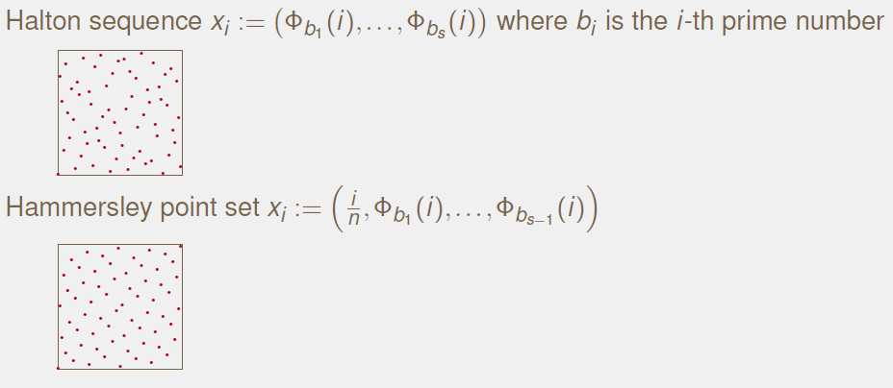
Radical inversion based points in higher dimension
Image credit: Alexander Keller

Slide 21
Použité pro path tracing
Cesty jsou body ve vysokodimenzionálním prostoru
Veškerá náhodná čísla použitá pro konstrukci jedné cestu jsou různé komponenty jednoho dlouhého „náhodného vektoru“
Další cesta – další náhodný vektor ve vysokodimenzionálním prostoru.
Pokud náhodné vektory dobře pokrývají vysokodimenzionální prostor, pak cesty dobře pokrývají celý prostor cest ve scéně

Slide 22
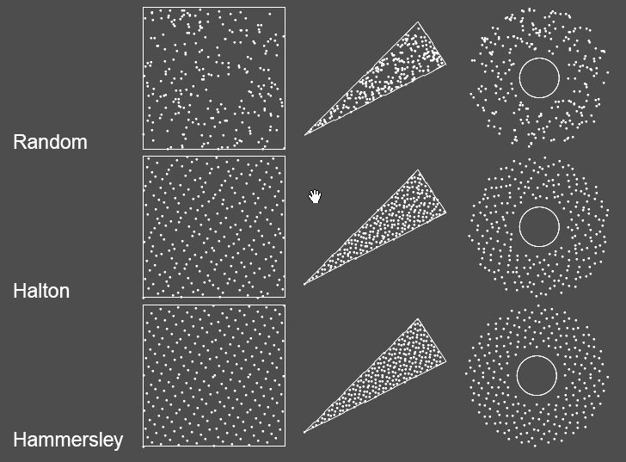
Transformace náhodných čísel
Image credit: Alexander Keller

Slide 23
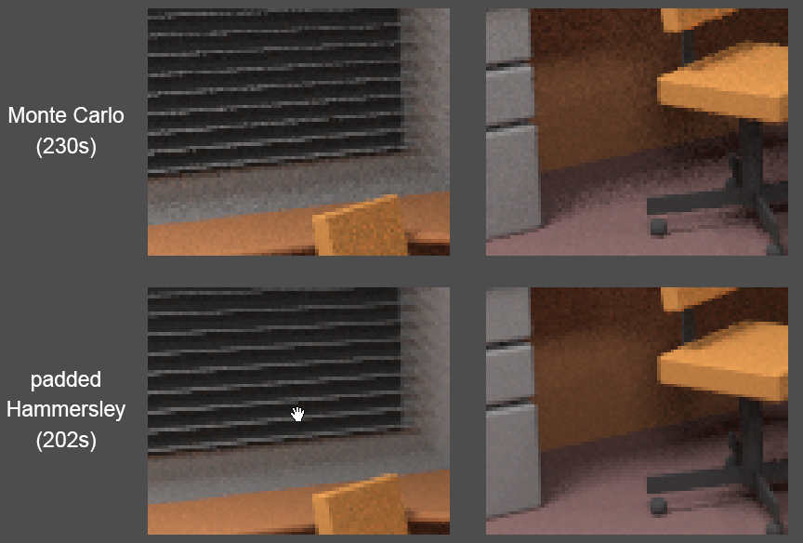
Ukázka výsledků pro MC a QMC
Image credit: Alexander Keller

Slide 24
Metody Quasi Monte Carlo (QMC)
Nevýhody QMC:
  V obrázku mohou vzniknout viditelné „vzory“ (místo šumu v MC)

Slide 25
Stratified sampling
Henrik Wann Jensen
10 cest na pixel

Slide 26
Quasi-Monte Carlo
Henrik Wann Jensen
10 cest na pixel

Slide 27
Fixní náhodná sekvence
Henrik Wann Jensen
10 cest na pixel

Slide 28
Měřicí rovnice

Slide 29
Měřicí rovnice
Zobrazovací rovnice
  Podmínky pro radianci v rovnovážném stavu
  Umožňuje výpočet radiance v izolovaných bodech
Ve skutečnosti nás zajímá průměrná radiance přes pixel: integrál
Měřicí rovnice (Measurement equation)

Slide 30
Měřicí rovnice
odezva virtuálního (lineárního)
senzoru na radianci (barva pixelu)
relativní odezva senzoru (váha)
různé W_{e} pro každý senzor (pixel)
přes celou plochu scény a všechny směry
(virtuální senzory musí být součástí scény,
nenulový příspěvek pouze na ploše senzoru kvůli W_{e})
Notes:
Nakreslit model senzoru (pixel)

Slide 31
Příklad: Zářivý tok přes oblast jako měřicí rovnice
Dána oblast S
(podmnožina povrchu scény a příslušných směrů)
Pro W_{e} definované
je výsledkem měřicí rovnice zářivý tok Φ(S).

Slide 32
Měřicí rovnice jako skalární součin funkcí
Definujeme skalární součin funkcí f a g:
Měřicí rovnice

Slide 33
Propagace radiance a důležitosti
L (radiance)
W (důležitost)

Slide 34
Důležitost (importance)
W_{e} popisuje, jak důležitá je příchozí radiance pro odezvu senzoru
1 krok do scény: Příchozí radiance na senzoru = odchozí radiance z bodů scény
2, 3, … kroky do scény: …
W_{e} interpretujeme jako veličinu emitovanou ze senzorů (stejně jako je radiance L_{e} emitovaná ze zdrojů světla)
Takto interpretovanou veličinu W_{e} nazýváme
emitovanou funkcí důležitosti
(emitted importance function, emitted potential function)

Slide 35
Přenos důležitosti
Funkce důležitosti se přenáší podobně jako radiance a dosahuje ustáleného stavu popsaného ustálenou funkcí důležitosti W:
Jako zobrazovací rovnice, s tím rozdílem,
že argumenty BRDF jsou přehozeny
(pro odraz identické, nikoli však pro lom)

Slide 36
Dualita důležitosti a radiance
emitovaná
importance
ustálená
příchozí
radiance
ustálená
příchozí
importance
emitovaná
radiance

Slide 37
Dualita důležitosti a radiance
V dané scéně je pouze jediná emitovaná a ustálená funkce radiance
Ale každý pixel má jinou emitovanou a ustálenou funkci důležitosti

Slide 38
Dualita v praxi: Sledování světla
Sledování cest (path tracing)
  Rekurzivně řeší zobrazovací rovnici
Sledování světla (light tracing)
  Rekurzivně řeší rovnici přenosu důležitosti
  Cesty začínají na zdrojích světla
  Mohou náhodně zasáhnout senzor
  Nebo explicitní napojení na senzor (jako přímé osvětlení v PT)
  Pozor: argumenty BRDF musí být obráceny (cestu sledujeme z druhé strany, BRDF je pořád stejně oprientovaná)

Slide 39
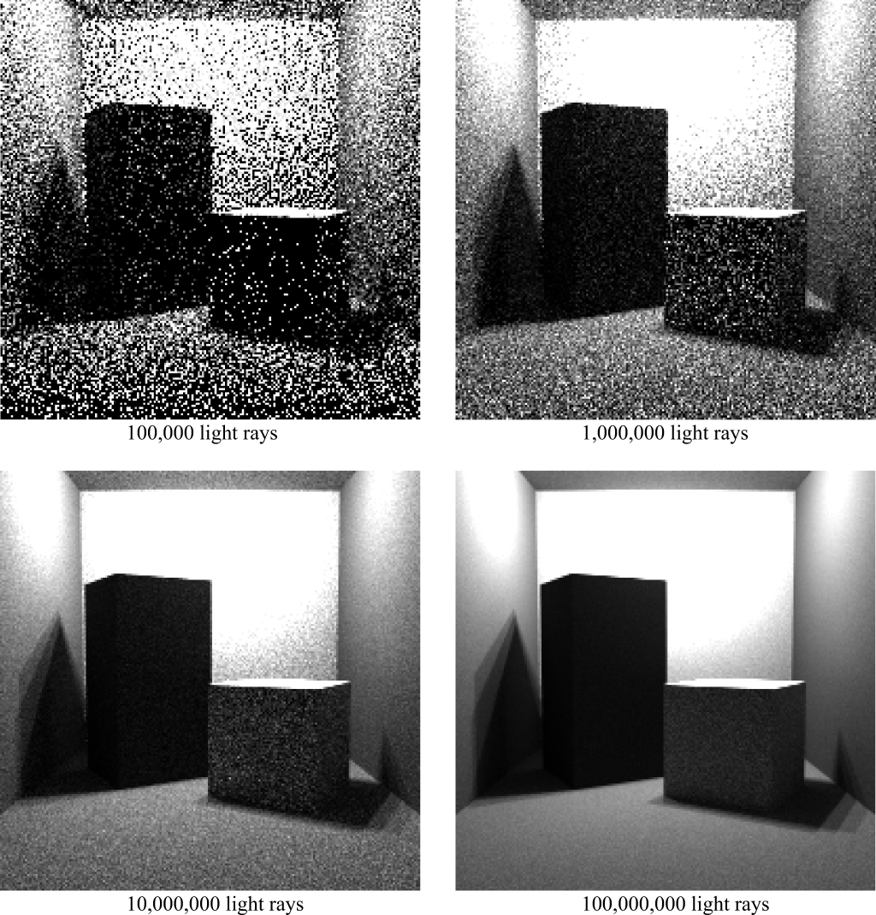
Sledování světla (light tracing) v praxi
Image: Dutre et al. Advanced Global Illumination

Slide 40
Sledování světla (light tracing) v praxi
Obvykle menší účinnost než PT
  (ale např. v opt. akt. médiu blízko světla mnohem lepší)
Mnohem účinnější pro některé světelné efekty (kaustiky)
Základ obousměrných metod:
  Obousměrné sledování cest (bidirectional path tracing, BPT)
  photon mapping, etc.

Slide 41
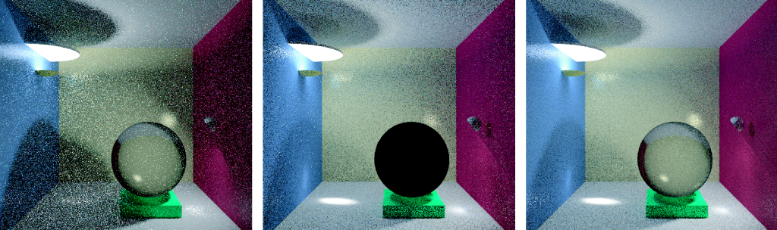
Porovnání algoritmů
© F. Suykens
Path tracing
Light tracing
Bidirectional path tracing
Kvíz: Proč je skleněná koule černá?

Slide 42
Pokročilé metody simulace transportu světla

Slide 43

Issues in light transport simulation
Robustness
  None of the existing algorithms works for all scenes
  Robust estimation
    “An estimation technique which is insensitive to small departures from the idealized assumptions which have been used to optimize the algorithm.”
Notes:
A number of light transport algorithms exist, such as path tracing (PT), bidirectional path tracing (BPT), photon mapping (PM), or Metropolis light transport (MLT); and there are many variants of these algorithms.
However, the single most pressing issue with all of these solutions is that none of them really works for all practical scenes.
In other words, these solutions are not robust enough.
Robustness of a statistical estimator (such as our rendering process) is defined by Wolframs MathWorld as follows: “An estimation technique which is insensitive to small departures from the idealized assumptions which have been used to optimize the algorithm.”
In rendering, it means that a robust algorithm should be reasonably efficient for any input scene. The current light transport algorithms unfortunately do not exhibit this desirable feature.

Slide 44
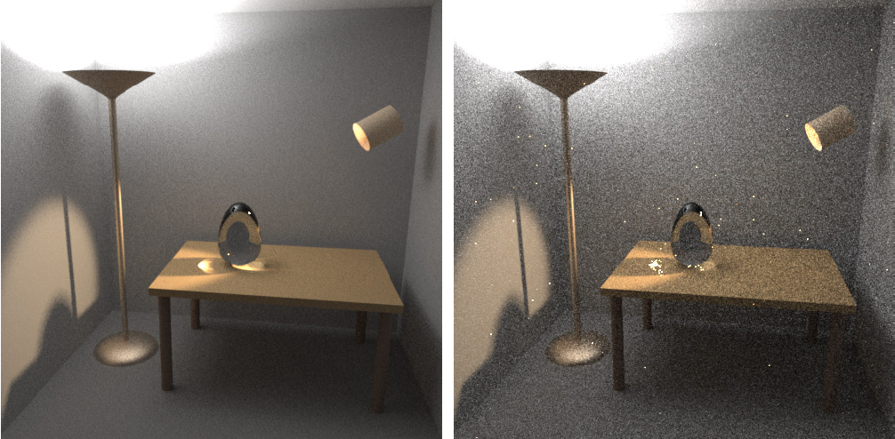
Obousměrné sledování cest (BPT) vs.
(Jednosměrné) sledování cest (PT)
Image: Eric Veach
BPT, 25 vzorků (cest) na pixel
PT, 56 vzorků (cest) na pixel

Slide 45
Přenos světla jako integrál přes prostor cest

Slide 46

Light transport
Geometric optics
emit
travel
absorb
scatter
Notes:
In the real world, light sources emit light particles, which travel in space, scatter at objects (potentially multiple times) until they are absorbed.
On their way, they might hit the sensor of the camera which will record the light contribution.

Slide 47
Light transport
emit
travel
absorb
scatter
light
transport
path
Notes:
The light particles travel along trajectories that we call “light transport paths”.
In an environment consisting of opaque surfaces in vacuum, these paths are polylines whose vertices correspond to scattering (reflection) at surfaces, and the straight edges correspond to light travelling the in free space.

Slide 48
Light transport
Camera response
  all paths hitting
  the sensor
Notes:
The final response of the camera is due to all the light particles – travelling over all possible paths – that hit the camera sensor during the shutter open period.

Slide 49
Path integral formulation
all paths
camera resp.
(j-th pixel value)
measurement
contribution
function
[Veach and Guibas 1995]
[Veach 1997]
Notes:
The path integral formulation of light transport formalizes this idea by writing the camera response (which, in image synthesis will be the value of a pixel) as an integral over all light transport paths of all lengths in the scene.
The integrand of this integral is the so called “measurement contribution function”.
The measurement contribution function of a given path encompasses the “amount” of light emitted along the path, the light carrying capacity of the path, and the sensitivity of the sensor to light brought along the path.

Slide 50
Measurement contribution function
emitted
radiance
path
throughput
sensor sensitivity
(“emitted importance”)
Notes:
Let us now look at a more formal definition of the measurement contribution for a light path.
As I already mentioned, a light transport path is a polyline with vertices corresponding to light scattering on surfaces.
We write the path simply as a sequence of vertices, in the order of the light flow. So the first vertex corresponds to light emission at the light source and the last vertex to light measurement at the sensor.
The measurement contribution function f(x) for a path x of length k is defined as the emitted radiance L_{e} at the first vertex, times the sensitivity (or “emitted importance”) W_{e} at the last vertex, times the path throughput T(x). The throughput is defined as the product of the geometric G and scattering terms associated with the path edges and interior vertices, respectively.

Slide 51
Geometry term
Notes:
The geometry term, or point-to-point form factor, of a path edge expresses the throughput of the edge due to geometry configuration of the scene, and is given by the product of the inverse-squared-distance, cosine factor at the vertices and the visibility term.

Slide 52
Path integral formulation
all paths
camera resp.
(j-th pixel value)
measurement
contribution
function
?
✓
Notes:
Back to the path integral…
We now know the meaning of the integrand – the path contribution function – but the integration domain “all path” needs more clarification.

Slide 53
Path integral formulation
all path
lengths
all possible
vertex positions
Notes:
The path integral actually hides an infinite sum over all possible path lengths.
Each summand of this sum is a multiple integral, where we integrate the path contribution over all possible positions of the path vertices.
So each of the integrals is taken over the Cartesian product of the surface of the scene with itself, taken k+1 times (=number of vertices for a length-k path.)
The integration measure is the area-product measure, i.e. the natural surface area, raised to the power of k+1.

Slide 54
Path integral
pixel value
all paths
contribution
function
Notes:
We now have a formula for pixel values that has a form of a simple (though infinite-dimensional) integral.
To render images, we need to numerically evaluate this integral for all image pixels.

Slide 55
Rendering :
Evaluating the path integral
Notes:
So the next section of this presentation well be devoted to numerical evaluation of the path integral.

Slide 56
Path integral
pixel value
all paths
contribution
function
Monte Carlo integration
Notes:
We will use Monte Carlo integration for this purpose.

Slide 57
Monte Carlo integration
General approach to numerical evaluation of integrals
Integral:
f(x)
Monte Carlo estimate of I:
p(x)
0
x₅
x₃
x₁
x₄
x₂
x₆
1
Correct „on average“:
Notes:
Let me briefly review the basic elements of MC integration.
Suppose we are given a real function f(x) and we want to compute the integral Int f(x) dx over some domain (in this example we use the interval [0,1] for simplicity, but the domain can be almost arbitrary.)
The Monte Carlo integration procedure consists in generating a ‘sample’, that is, a random x-value from the integration domain, drawn from some probability distribution with probability density p(x). In the case of path integral, the x-value is an entire light transport path.
For this sample x_{i}, we evaluate the integrand f(x_{i}), and the probability density p(x_{i}).
The ratio f(x_{i}) / p(x_{i}) is an estimator of the integrand. To make the estimator more accurate (i.e. to reduce its variance) we repeat the procedure for a number of random samples x₁, x₂, …, x_{N} , and average the result as shown in the formula on the slide.
This procedure provides an unbiased estimator of the integrand, which means that “on average”, it produces the correct result i.e. the integral that we want to compute.

Slide 58
MC evaluation of the path integral
Path integral
MC estimator
Sample path from some distribution with PDF
Evaluate the probability density
Evaluate the integrand
?
?
✓
Notes:
Thanks to the formal simplicity of the path integral formulation, applying Monte Carlo integration is really a more-or-less mechanical process.
For each pixel, we need to repeatedly evaluate the estimator shown at the top right of the slide and average the estimates.
This involves the following three steps:
First, we need to draw (or sample, or generate – all are synonyms) a random light transport path x in the scene (connecting a light source to the camera).
Then we need to evaluate the probability density of this path, and the contribution function.
Finally, we simply evaluate the formula at the top of the slide.
Evaluating the path contribution function is simple – we have an analytic formula for this that takes a path and returns a number – the path contribution.
However, we have not discussed so far how paths can be sampled and how the PDF of the resulting path can be evaluated.

Slide 59
Path sampling
Algorithms = different path sampling techniques
Notes:
Path sampling techniques and the induced path PDF are an essential aspect of the path integral framework.
In fact, from the point of view of the path integral formulation, the only difference between many light transport simulation algorithms are the employed path sampling techniques and their PDFs.

Slide 60
Path sampling
Algorithms = different path sampling techniques
  Path tracing
Notes:
For example, path tracing samples paths by starting at the camera sensor, and extending the path by BRDF importance sampling, and possibly explicitly connecting a to a vertex sampled on the light source.

Slide 61
Path sampling
Algorithms = different path sampling techniques
  Light tracing
Notes:
Light tracing, on the other hand, starts paths at the light sources.

Slide 62
Path sampling
Algorithms = different path sampling techniques
  Bidirectional
  path tracing
Notes:
Bidirectional path tracing combines many different path sampling techniques, including those employed by path tracing and light tracing. On top of this, it add techniques where a piece of the path is generated starting from the camera, another piece starting from the light source, and the end-vertices of these sub-paths are connected to create a full light transport path.

Slide 63
Path sampling
Algorithms = different path sampling techniques
Same general form of estimator
No importance transport, no adjoint equations!!!
Notes:
Though path tracing and light tracing may seem like very different algorithms, from the path integral point of view they are essentially the same.
The only difference is the path sampling procedure, and the associated path PDF.
But the general Monte Carlo estimator is exactly the same – only the PDF formula changes.
Without the path integral framework, we would need equations of importance transport to formulate light tracing, which can get messy.

Slide 64
Path sampling
&
Path PDF
Notes:
So how exactly do we sample the paths and how do we compute the path PDF?

Slide 65
Local path sampling
Sample one path vertex at a time
From an a priori distribution
  lights, camera sensors
Sample direction from an existing vertex
Connect sub-paths
  test visibility between vertices
Notes:
Most of the practical algorithms rely on local path sampling, where paths are build by adding one vertex at a time until a complete path is built.
There are three common basic operations.
First, we can sample a path vertex from an a priori given distribution over scene surfaces. We usually employ this technique to start a path either on a light source or on the camera sensor.
Second, given a sub-path that we’ve already sampled with a vertex at its end, we may sample a direction from that vertex, and shoot a ray in this direction to obtain the next path vertex.
Finally, given two sub-paths, we may connect their end-vertices to form a full light transport path. This technique actually does not add any vertex to the path. It is more or less a simple visibility check to see if the contribution function of the path is non-zero.

Slide 66
Example – Path tracing
A priori distrib.
Direction sampling
Connect vertices
1.
2.
1.
3.
2.
2.
Notes:
Let us see how these three basic operations are used in a simple path tracer.
First, we generate a vertex on the camera lens, usually from a uniform distribution over the lens surface – so this corresponds to operation 1.
Second, we pick a random direction form this point such that it passes through the image plane, and shoot a ray to extend the path. This is operation 2.
Third, we may generate an independent point on the light source (operation 1) and test visibility (operation 3) to form a complete light transport path.
We could also continue the path by sampling a random direction and shooting a ray (operation 2), and eventually hit the light source to complete the path.
An important thing to notice is that one single primary ray from the camera actually creates a full family of light transport paths. These path are correlated, because they share some of the path vertices, but they are distinct entities in the path space.

Slide 67
Use of local path sampling
Bidirectional
path tracing
Path tracing
Light tracing
Notes:
These same basic operations are used to construct paths in light tracing and bidirectional path tracing.

Slide 68
Probability density function (PDF)
path PDF
joint PDF of path vertices
Notes:
Not that we know how to construct a path, we need to evaluate its PDF so that we can plug it into the MC estimator.
In general the PDF of a light path is simply the joint PDF of the path vertices.
That is to say, the PDF that the first vertex is where it is and the second vertex is where it is, etc.

Slide 69
Probability density function (PDF)
path PDF
joint PDF of path vertices

Slide 70
Probability density function (PDF)
path PDF
joint PDF of path vertices
product
of (conditional)
vertex PDFs
Path tracing example:
Notes:
The joint path PDF is given by the product of the conditional vertex PDF.
To see what this means, let us again take the example of path tracing, where we build a path starting from the camera.
Vertex x₃ comes from an a priori distribution p(x₃) over the camera lens (usually uniform; or the delta distribution for a pinhole camera).
Vertex x₂ is sampled by generating a random direction from x₃ and shooting a ray. This induces a PDF for x₂, p(x₂ | x₃), which is in fact conditional on vertex x₃.
The same thing holds for vertex x₁, which is sampled by shooting a ray in a random direction from x₂.
Finally, vertex x₀ on the light source might be sampled from an uniform distribution over the light source area with pdf p(x₀), independently of the other path vertices.
The full joint PDF is given by the product of all these individual terms.

Slide 71
Probability density function (PDF)
path PDF
joint PDF of path vertices
product
of (conditional)
vertex PDFs
Path tracing example:
Notes:
It is customary to simplify this somewhat pedantic notation and leave out the conditional signs. Nonetheless, it is important to keep in mind that the path vertex PDFs for vertices that are not sampled independently are indeed conditional PDFs.

Slide 72
Vertex sampling
emission
sampling
Importance sampling principle
Sample from an a priori distrib.
Sample direction from an existing vertex
Connect sub-paths
BRDF lobe
sampling
high thruput
connections
Notes:
In accordance with the principle of importance sampling, we want to generate full paths paths from a distribution with probability density proportional to the measurement contribution function. That is, high-contribution paths should have proportionally high probability of being sampled.
Local path sampling takes an approximate approach, where each local sampling operation tries to importance sample the terms of the contribution function associated with the vertex being sampled.
For example, when starting a path on the light source, we usually sample the initial vertex from a distribution proportional to the emitted power.
When extending the path from an existing vertex, we usually sample the random direction proportionally to the BRDF at the vertex.
Similarly, when connecting two sub-paths with an edge, we may want to prefer connections with high throughput (though this is rarely done in practice).

Slide 73
Vertex sampling
Sample direction from an existing vertex
BRDF lobe
sampling

Slide 74
Measure conversion
Sample direction from an existing vertex
BRDF lobe
sampling
w.r.t. area
w.r.t. proj.
solid angle
Notes:
There is one important technical detail associated with computing the path PDF for vertices created by direction sampling.
The path integral is expressed with respect to the surface area measure – we are integrating over the surface of the scene – but the direction sampling usually gives the PDF with respect to the (projected) solid angle.
The conversion factor from the projected solid angle measure to the area measure is the geometry factor.
This means that any vertex generated by first picking a direction and then shooting a ray has the geometry factor of the generated edge importance sampled – the only geometry factor that are not importance sampled actually correspond to the connecting edges (operation 3 in local path sampling).

Slide 75
Summary
Path integral
MC estimator
pixel value
all paths
contribution
function
sampled
path
path pdf
Notes:
At this point, we should summarize the mathematical development so far.
The path integral formulation gives the pixel value as an integral over all light transport paths of all lengths.
A light transport path is the trajectory of a light carrying particle. It is usually a polyline specified by its vertices.
The integrand is the measurement contribution function, which is the product of emitted radiance, sensor sensitivity, and path throughput.
Path throughput is the product of BRDFs at the inner path vertices and geometry factors at the path edges.
To evaluate the integral, we use Monte Carlo estimator in the form shown at the top right of the slide.
To evaluate the estimator, we need to sample a random path from a suitable distribution with PDF p(x).
We usually use local path sampling to construct the paths, where we add one vertex at a time. In this case, the full path PDF is given by the product of the (conditional) PDFs for sampling the individual path vertices.

Slide 76
Summary
Algorithms
  different path sampling techniques
  different path PDF
Notes:
From the point of view of the path integral framework, different light transport algorithms (based on Monte Carlo sampling) only differ by the path sampling techniques employed.
The different sampling techniques imply different path PDF and therefore different relative efficiency for specific lighting effects. This will be detailed in the next part of the course.

Slide 77
Odvození integrálu přes prostor cest ze zobrazovací a měřicí rovnice

Slide 78
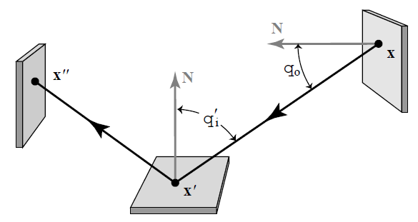
Tříbodová formulace přenosu světla
Eliminace směrů (pouze body na ploše)

Slide 79
Zobrazovací rovnice v 3b formulaci

Slide 80
Měřicí rovnice v 3b formulaci
Důležitost emitovaná z x’ do x
(Značení: šipka = směr šíření světla, nikoli důležitosti)
x’ ... na senzoru
x … na ploše scnény

Slide 81
Odvození integrálu přes prostor cest
Do měřicí rovnice v 3b formulaci se dosadí Neumannova expanze ZR v 3b formulaci, vypadne suma integrálů.
Integrand je funkcí příspěvku (contribution function).

Slide 82
“Path integral” – A historical remark
This course [Veach and Guibas 1995], [Veach 1997]
  Easily derived form the rendering equation [Veach 1997]
Feynman path integral formulation of quantum mechanics [Feynman and Hibbs 65]
Homogeneous materials [Tessendorf 89, 91, 92]
Rendering [Premože et al. 03, 04]
Notes:
The term “path integral formulation” has a different meaning for different people.
What I’ve presented in this course has been derived by Veach and Guibas by fairly straightforward manipulation of the Neumann series solution of the rendering equation.
More widely known is Feynman’s path integral formulation, used to solve problems in quantum mechanics. In this formulation the transport paths are general curves, so the path space that we considered here (polylines) is just a small sub-space (of measure zero) of the path space in Feynman’s formulation.
Tessendorf used Feynman’s path integral formulation to derive the solution of light transport in strongly forward scattering media.
This solution has been used for rendering by Premože and colleagues.

Slide 83
Obousměrné sledování cest
(Bidirectional path tracing)

Slide 84
Bidirectional path sampling
Algorithms = different path sampling techniques
Bidirectional
path tracing
Path tracing
Light tracing
Notes:
In the previous part of the course, I said that from the point of view of the path integral framework, the major difference between different LTS algorithms is the employed path sampling technique.
In this part of the course, we will focus on bidirectional path sampling techniques, that build a sub-path from the camera and from the light source and connect the two sub-paths to generate an entire path. Such sampling techniques are employed in the bidirectional path tracing algorithm.

Slide 85
One bidirectional path sampling technique
sample light sub-path
sample camera sub-path
sub-path connection
Notes:
Let’s now look at the exact same process in the path integral framework.
In the first step, we distribute the VPLs. Of course, that is nothing else than sampling sub-paths starting from a light source.
Finding out a point visible through a pixel from the camera involves building a length-1 sub-path from the camera.
And finally, evaluating the VPL contribution completes a full light transport path by connecting two sub-paths together.

Slide 86
One bidirectional path sampling technique
The usual path integral estimator
connection terms
Notes:
Once again, we use the exact same general form the of path integral estimator, that is the value of the measurement contribution function divided by the path PDF.
Again, the measurement contribution function is given by the product of the emission, sensor sensitivity, BSDFs at the path vertices, and the geometry terms for the path segments.
And notice that the factor of the contribution function associated with the VPL connection edge are exactly the terms that need to be evaluated when computing the contribution of a VPL.
So how does the path PDF looks like?

Slide 87
Digression
Sample direction from an existing vertex
w.r.t. area
w.r.t. proj.
solid angle
Notes:
To see that, I will allow myself a little digression back to a slide I showed a couple of minutes ago.
On this slide I was showing that every time we sample a vertex, y in this example, by picking a random direction from another vertex, x here, and shooting a ray, we automatically importance sample the geometry term along the edge.
However, the geometry term for edges constructed by connection are not importance sampled.

Slide 88
One bidirectional path sampling technique
The usual estimator





Connection term
Notes:
So we see here that the geometry terms for the segments on the light and camera sub-path are importance sampled.
Also, the radiance emission and sensor sensitivity are importance sampled because we usually pick the initial path vertex and initial direction proportional to these quantities.
But notice that none of the quantities associated to the connecting edge are importance sample – Indeed, we just blindly connect two vertices. And that’s exactly where all the problems with VPLs are coming from.

Slide 89
All possible bidirectional techniques
vertex on a light sub-path
vertex on en eye subpath

path tracing


VPLs



light tracing
Notes:
This slide schematically shows all the possible bidirectional techniques that we can obtain by starting a path either on light source or on the camera and applying only the basic three operations of local path sampling for an example path of length 4.
The first two cases correspond to what a regular path tracer usually does (randomly hitting the light sources and explicit light source connections.)
The fourth correspond to VPL sampling.
And the last two are complementary to the first two and therefore correspond to light tracing.
Each sampling technique importance samples a different subset of terms of the measurement contribution function.
However, in each of these techniques, there are some terms of the measurement contribution function that are not importance sampled.
The purely unidirectional techniques (top and bottom) do not importance sample the light emission and sensor sensitivity, respectively. Indeed, for example the technique at the top relies on randomly hitting a light source, without incorporating any information about the location of light sources in the scene.
All the bidirectional techniques, that is, those that involve connection of two sub-paths, are unable to importance sample the terms associated with the connection edge, exactly as in the case of VPLs.

Slide 90
All possible bidirectional techniques
vertex on a light sub-path
vertex on en eye subpath

path tracing

no single technique importance
samples all the terms

VPLs



light tracing
Notes:
But none of the techniques shown here is able to importance sample all of the terms of the measurement contribution function.

Slide 91
Multiple Importance Sampling (MIS)
[Veach & Guibas, 95]
Combined
estimator:
f(x)
p_{a}(x)
p_{b}(x)
x_{a}
Notes:
This slide shows this situation in a simpler setting. We have a complex multimodal integrand f(x) and we have no single PDF that is proportional to the integrand in the entire domain.
But we do have two distributions with PDFs p_{a} and p_{b} each of which is a good match for the integrand under different conditions.
We can use Multiple Importance Sampling (MIS) to combine the sampling techniques corresponding to the two PDFs into a single, robust, combined technique.
MIS proceeds by first picking one distribution to sample from (p_{a} or p_{b} , say with fifty-fifty chance) and then taking the sample from the selected distribution.
This essentially corresponds to sampling from a weighted average of the two distributions, which is reflected in the form of the estimator, shown on the slide.
This estimator is really powerful at suppressing outlier samples such as those that you would obtain by picking x_from the tail of p_{a}, where f(x) might still be large.
Without having p_{b} at our disposal, we would be dividing the large f(x) by the small p_{a} (x), producing an outlier.
However, the combined technique has a much higher chance of producing this particular x (because it can sample it also from p_{b}), so the combined estimator divides f(x) by [p_{a} (x) + p_{b}(x)] / 2, which yields a much more reasonable sample value.

Slide 92
Multiple Importance Sampling (MIS)
High MIS weight
Low MIS weight
Singularity cancelled
Notes:
Applying this to path sampling, this technique will weight down a lot the contribution of paths with short connecting edges, suppressing the high variance observed in the VPL methods.

Slide 93
Bidirectional path tracing
Use all of the above sampling techniques
Combine using Multiple Importance Sampling
Notes:
The main idea of bidirectional path tracing is to use all of the sampling techniques above and combine them using multiple importance sampling.

Slide 94
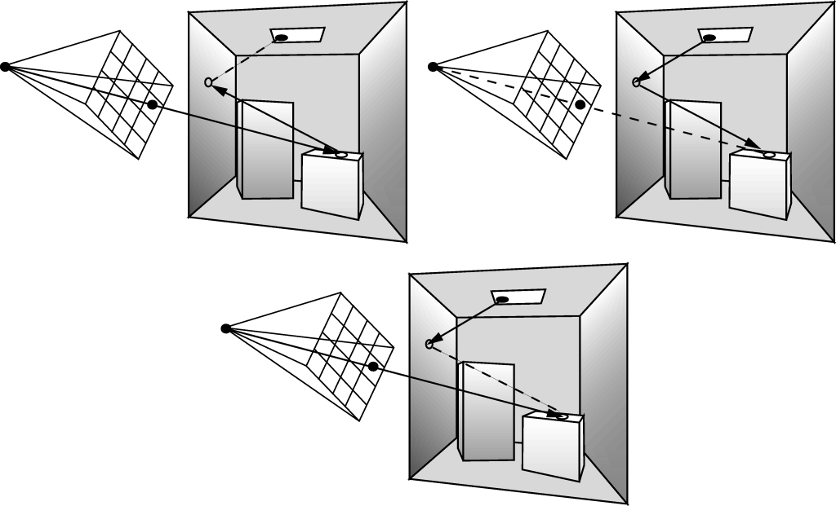
Vzorkovací strategie
Image: Dutre et al. Advanced Global Illumination

Slide 95
Obousměrné sledování cest
Zobecnění kombinované strategie pro výpočet přímého osvětlení v path traceru
Přímé osvětlení
  Různé strategie nalezení vzorkování bodu na zdroji světla
BPT
  Různé strategie generovaní celých světelných cest

Slide 96
Obousměrné sledování cest
Pro danou světelnou cestu:
  Funkce příspěvku f_{j}() nezávisí na způsobu vzorkování
  Hustota pravděpodobnosti závisí na způsobu vzorkování

Slide 97
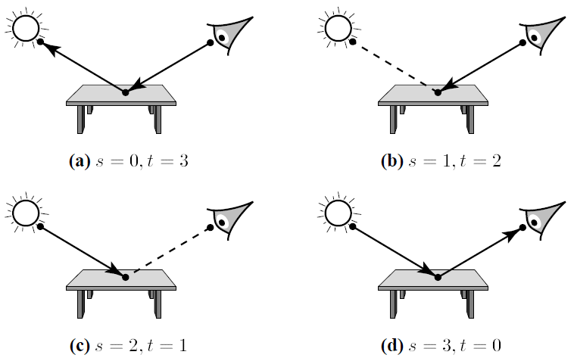
Vzorkovací techniky v BPT
Příklad: Čtyři vzorkovací techniky pro k = 2
Image: Eric Veach

Slide 98
Vzorkovací techniky v BPT
Podcesta o t vrcholech vzorkovaná z kamery
Podcesta o s vrcholech vzorkovaná ze světla
Spojovací segment délky 1
Celková délka cesty: k = s + t – 1 (segmentů)
k+2 možností pro generování cesty délky k

Slide 99
Vzorkovací techniky v BPT
Každá technika má jinou hustotu p_{s,t}
Každá je účinná při vzorkování jiných světelných efektů
Všechny techniky odhadují stejný integrál

Slide 100
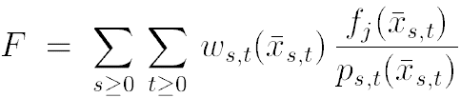
Kombinace vzorkovacích technik
Kombinovaný estimátor (MIS)
kombinační strategie
(např. vyvážená heuristika)

Slide 101
BPT Implementation
Notes:
The usual description of bidirectional path tracing, where two independent sub-paths are generated first, and the each vertex from the first is connected to each vertex of the second, is really just an implementation detail. It does improve the efficiency thanks to reuse of the sub-paths, but does not contribute to the robustness of BPT in any way.

Slide 102



Implementace:
Generování cest po skupinách
Generuj podcestu náhodné délky od světla
Generuj podcestu náhodné délky od kamery
Spoj každý prefix cesty od světla s každým sufixem cesty od kamery
(cesta = vzorek z hustoty p_{s,t})

Slide 103
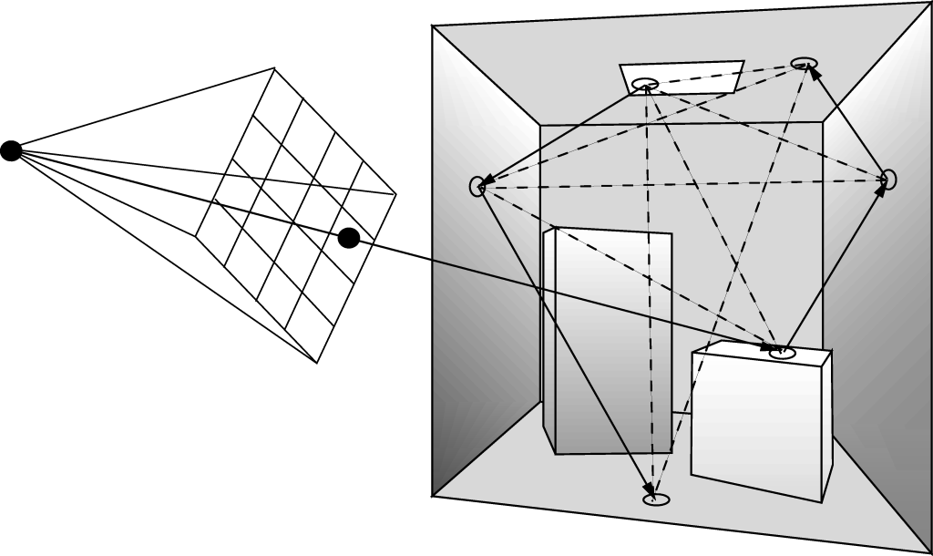
Generování cest po skupinách
Image: Dutre et al. Advanced Global Illumination

Slide 104
Results
Images: Eric Veach
BPT, 25 samples per pixel
PT, 56 samples per pixel

Slide 105
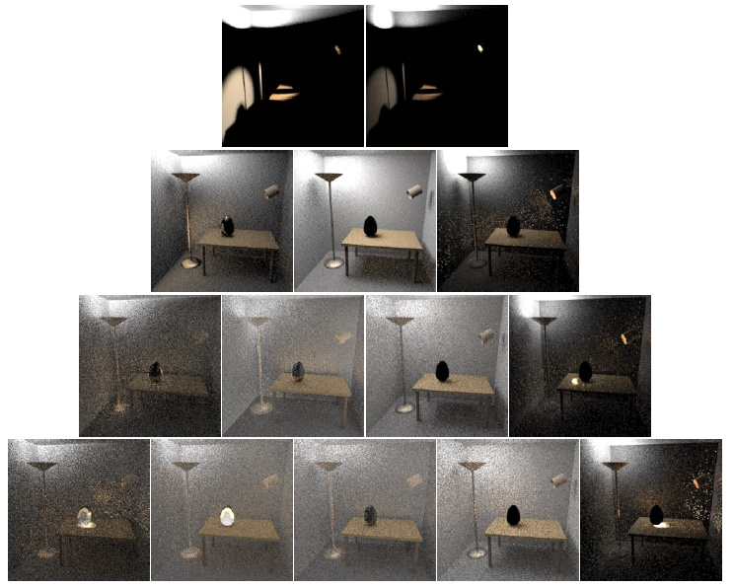
k = 2
(2x)
k = 3
(4x)
k = 4
(8x)
k = 5
(16x)
s = 1
s = 2 ...
t = 2
t = 1
s / t = počet vrcholů na podcestě od světla / kamery

Slide 106
Porovnání algoritmů
© F. Suykens
Path tracing
Light tracing
Bidirectional path tracing
Kvíz: Proč je skleněná koule černá?

Slide 107
Limitations of local path sampling

Slide 108
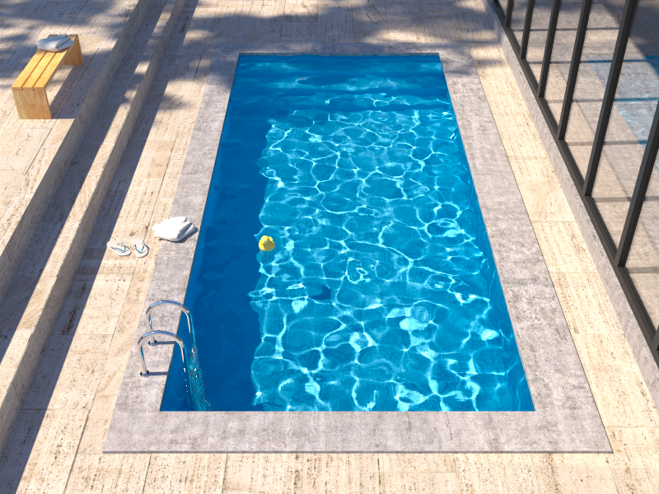
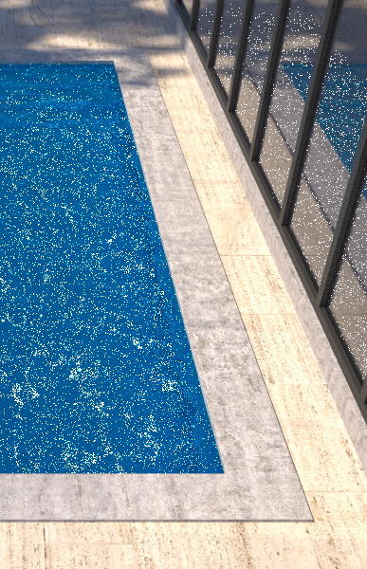
Insufficient path sampling techniques
Reference solution
Bidirectional path tracing
Notes:
Bidirectional path tracing is much more robust than path tracing, light tracing, or VPL rendering.
However, it still struggles with some lighting effects, the most common of which are the specular-diffuse-specular (SDS) paths corresponding to reflected caustics – in this example the caustics at the pool bottom.

Slide 109
Insufficient path sampling techniques
Some paths sampled with zero (or very small) probability
specular – S
diffuse – D
Notes:
As usual, the culprit is inappropriate path sampling. The problem is that none of the path sampling techniques used in bidirectional path tracing is efficient at sampling the SDS effects, so their combination cannot sample those effects either.
To see this, consider the example on the slide. We have a pool (diffuse – D) filler with water (specular – S), a pinhole camera, and a small light source.
No path connections are possible because of the two specular vertices. Unidirectional sampling from the light source is not possible either because of the pinhole camera.
So we are left with one single (unidirectional) path sampling technique that starts from the camera, and hopes to randomly strike the light source. It is not hard to see that the smaller the source, the lower the probability of hitting the source and the higher the estimator variance.
In the limit, for point sources and pinhole camera, the SDS effects cannot be sampled by local path sampling at all.

Slide 110
Alternatives to local path sampling
Global path sampling – Metropolis light transport
  Initial proposal still relies on local sampling
Leave path integral framework
  Density estimation – photon mapping
Unify path integral framework and density estimation
  Vertex Connection & Merging
Notes:
To sample SDS effects efficiently, we need to look for alternatives to local path sampling.
One such alternative are global path sampling techniques that sample a path as a whole, as opposed to incrementally vertex-by-vertex. This is for example the case of Metropolis light transport and other Markov Chain Monte Carlo techniques. The issue is that the Markov chain of path mutations needs to be initialized with some path, and this path has to be generated somehow – and we’re back to local path sampling.
We could also look for an entirely different solution of light transport, outside the classic path integral formulation. A popular example of this approach is photon mapping, which relies on density estimation.
However, photon mapping is fairly inefficient at some lighting effects (such as diffuse inter-reflections) which are very efficiently handled by the path sampling techniques in BPT.
So the vertex connection and merging algorithm reformulates photon mapping in the path integral framework, which enables a robust combination of photon mapping and BPT using Multiple Importance Sampling.

Slide 111
Nearly there…

Slide 112
“Path integral” – A historical remark
This course [Veach and Guibas 1995], [Veach 1997]
  Easily derived form the rendering equation [Veach 1997]
Feynman path integral formulation of quantum mechanics [Feynman and Hibbs 65]
Homogeneous materials [Tessendorf 89, 91, 92]
Rendering [Premože et al. 03, 04]
Notes:
The term “path integral formulation” has a different meaning for different people.
What I’ve presented in this course has been derived by Veach and Guibas by fairly straightforward manipulation of the Neumann series solution of the rendering equation.
More widely known is Feynman’s path integral formulation, used to solve problems in quantum mechanics. In this formulation the transport paths are general curves, so the path space that we considered here (polylines) is just a small sub-space (of measure zero) of the path space in Feynman’s formulation.
Tessendorf used Feynman’s path integral formulation to derive the solution of light transport in strongly forward scattering media.
This solution has been used for rendering by Premože and colleagues.

Slide 113
Konec
E. Veach: Robust Monte Carlo methods for light transport simulation, PhD thesis, Stanford University, 1997, pp. 219-230, 297-317
http://www.graphics.stanford.edu/papers/veach_thesis/

